Slide 1
Introduction to Philosophy
Doing Philosophy: Fallacies
Reviewing last session:
STRUCTURE OF AN ARGUMENT
VALID ARGUMENT
If premises are true, conclusion is true
SOUND ARGUMENT
A valid argument with true premises
NECESSARY CONDITION
Q is true only if P is true
SUFFICIENT CONDITION
If R is true, then S is true

Slide 2
Introduction to Philosophy
Doing Philosophy: Fallacies
fal·la·cy
a mistaken belief, especially one based on unsound argument.
in logic:
a failure in reasoning that renders an argument invalid.
Informal fallacy
Formal fallacy

Slide 3
Introduction to Philosophy
Doing Philosophy: Fallacies
Formal fallacy:
Affirming the consequent
Valid
Invalid
If P, then Q.
P.
Therefore, Q.
If P, then Q.
Q.
Therefore, P.

Slide 4
Introduction to Philosophy
Doing Philosophy: Fallacies
Formal fallacy:
Denying the antecedent
Valid
Invalid
If P, then Q.
P.
Therefore, Q.
If P, then Q.
not P.
Therefore, not Q.
P is sufficient for Q
but P is not necessary for Q

Slide 5
Introduction to Philosophy
Doing Philosophy: Fallacies
Informal fallacies

Slide 6
Introduction to Philosophy
Doing Philosophy: Fallacies
Premise 1: Peter is a bad person
Premise 2: Peter says X
Conclusion: X is wrong

Slide 7
Introduction to Philosophy
Doing Philosophy: Fallacies
Subtypes of the ad hominem fallacy
Poisoning the well – presenting adverse information about a target person with the intention of discrediting everything that the target person says.
Appeal to motive – dismissing an idea by questioning the motives of its proposer.
Tone policing – focusing on emotion behind a message rather than the message itself as a discrediting tactic.

Slide 8
Introduction to Philosophy
Doing Philosophy: Fallacies
Premise 1: Peter is a genius
Premise 2: Peter says X
Conclusion: X is right

Slide 9
Introduction to Philosophy
Doing Philosophy: Fallacies
Premise 1: Everybody says that X
Conclusion: X is right

Slide 10
Introduction to Philosophy
Doing Philosophy: Fallacies
Premise 1: You have said X
Premise 2: X is not true
Promise 3: People who say untrue things are liars
Conclusion: You are a liar
Response:
No! You are a liar!

Slide 11
Introduction to Philosophy
Doing Philosophy: Fallacies
Premise 1: Peter says X
Premise 2: X is wrong
Conclusion: Peter is wrong

Slide 12
Introduction to Philosophy
Doing Philosophy: Fallacies
Premise 1: I don’t understand X
Premise 2: What I don’t understand is wrong
Conclusion: X is wrong

Slide 13
Introduction to Philosophy
Doing Philosophy: Fallacies
Premise 1: You can’t proof that not-X
Premise 2: Things that you cannot proof are not true
Conclusion: not-X is not true
Premise 1: not-X is not true
Premise 2: Either X is true or not-X is true
Conclusion: X is true

Slide 14
Introduction to Philosophy
Doing Philosophy: Fallacies
If P, then Q.
Q.
Therefore, P.
That’s a fallacy (affirming the consequent), but that doesn’t mean that “not P”

Slide 15
Introduction to Philosophy
Doing Philosophy: Fallacies
"Should a smack as part of good parental correction be a criminal offence in New Zealand?“
“Have you stopped beating your wife?”

Slide 16
Introduction to Philosophy
Doing Philosophy: Fallacies
Premise 1: All feathers are light
Premise 2: What is light cannot be dark
Conclusion: No feather is dark
Refusing to give up personal freedom to help fight terrorism is un-American
Giving up personal freedom to help fight terrorism is un-American

Slide 17
Introduction to Philosophy
Doing Philosophy: Fallacies
Premise 1: I am aware of X happening
Premise 2: I am unaware of Y happening
Conclusion: X is more likely than Y

Slide 18
Introduction to Philosophy
Doing Philosophy: Fallacies

Slide 19
Introduction to Philosophy
Doing Philosophy: Fallacies

Slide 20
Introduction to Philosophy
Doing Philosophy: Fallacies
1. Erica: "How do you know that the bible is divinely inspired?" Pedro: "Because is says right in the third chapter of II Timothy that 'all scripture is given by divine inspiration of God.'"
2. Celibacy is an unnatural and unhealthy practice, since it is neither natural nor healthy to exclude sexual activity from one's life.
3. Thoughts are not part of the physical world, since thoughts are in their nature non-physical.
4. Happiness is the highest good for a human being, since all other values are inferior to it.
5. Of course smoking causes cancer. The smoke from cigarettes is a carcinogen.

Slide 21
Introduction to Philosophy
Doing Philosophy: Fallacies

Slide 22
Introduction to Philosophy
Doing Philosophy: Fallacies
Premise 1: X is f
Premise 2: X is a part of Y
Conclusion: Y is f

Slide 23
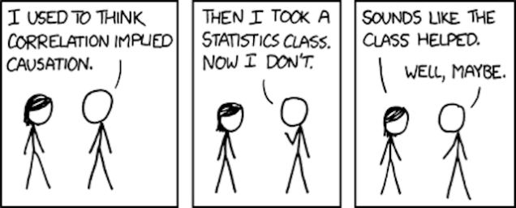
Introduction to Philosophy
Doing Philosophy: Fallacies

Slide 24
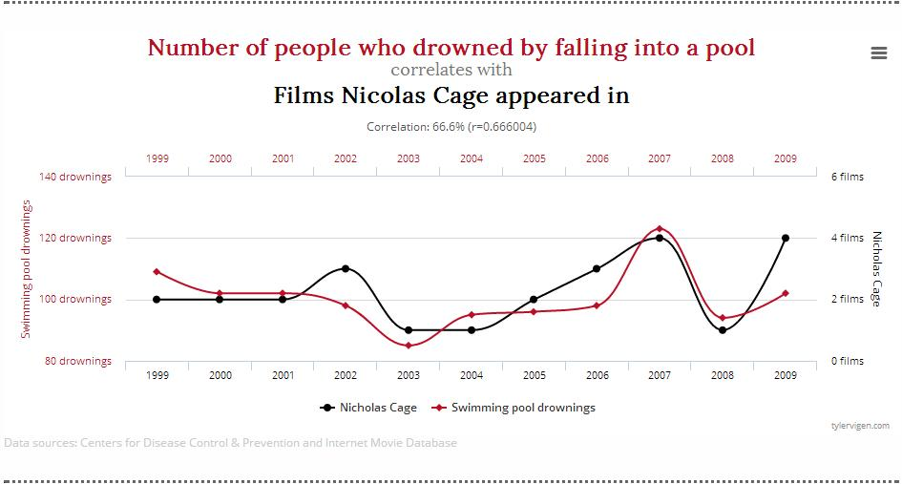
Introduction to Philosophy
Doing Philosophy: Fallacies

Slide 25
Introduction to Philosophy
Doing Philosophy: Fallacies
Chen, Daniel; Moskowitz, Tobias J.; Shue, Kelly "Decision-Making Under the Gambler's Fallacy: Evidence from Asylum Judges, Loan Officers, and Baseball Umpires". The Quarterly Journal of Economics: qjw017.
related fallacies:
the “hot hand” fallacy
the “near miss” fallacy

Slide 26
Introduction to Philosophy
Doing Philosophy: Fallacies
Premise 1: A is too much
Premise 2: B is not enough
Conclusion: (A+B)/2 is the right amount
also known as: Goldilock fallacy
Half way between the truth and a lie there is another lie

Slide 27
Introduction to Philosophy
Doing Philosophy: Fallacies
Premise 1: If X happens, then Y will happen
Premise 2: We don’t want Y to happen
Conclusion: We don’t want X to happen

Slide 28
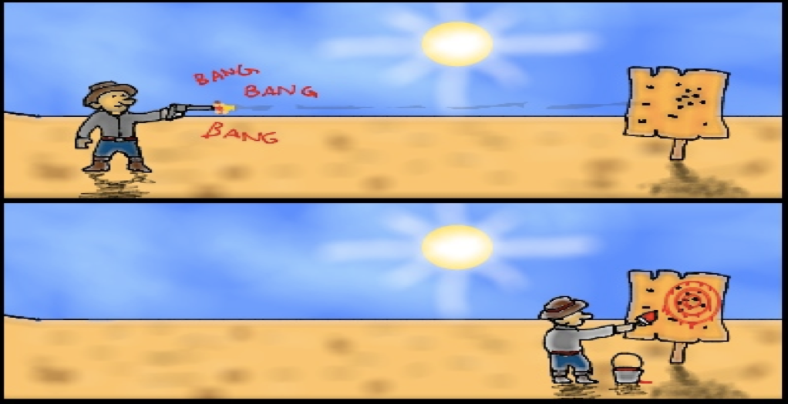
Introduction to Philosophy
Doing Philosophy: Fallacies

